Slide 1

The Memory System
PowerPoint Slides
Processor Design
The Language of Bits
Computer Organisation and Architecture
Smruti Ranjan Sarangi, IIT Delhi
Chapter 10 The Memory System
PROPRIETARY MATERIAL. © 2014 The McGraw-Hill Companies, Inc. All rights reserved. No part of this PowerPoint slide may be displayed, reproduced or distributed in any form or by any means, without the prior written permission of the publisher, or used beyond the limited distribution to teachers and educators permitted by McGraw-Hill for their individual course preparation. PowerPoint Slides are being provided only to authorized professors and instructors for use in preparing for classes using the affiliated textbook. No other use or distribution of this PowerPoint slide is permitted. The PowerPoint slide may not be sold and may not be distributed or be used by any student or any other third party. No part of the slide may be reproduced, displayed or distributed in any form or by any means, electronic or otherwise, without the prior written permission of McGraw Hill Education (India) Private Limited.
1

Slide 2

These slides are meant to be used along with the book: Computer Organisation and Architecture, Smruti Ranjan Sarangi, McGrawHill 2015
Visit: http://www.cse.iitd.ernet.in/~srsarangi/archbooksoft.html

Slide 3

Outline
Overview of the Memory System
Caches
Details of the Memory System
Virtual Memory

Slide 4
Need for a Fast Memory System
We have up till now assumed that the memory is one large array of bytes
Starts a 0, and ends at (2³² – 1)
Takes 1 cycle to access memory (read/write)
All programs share the memory
We somehow magically avoid overlaps between programs running on the same processor
All our programs require less than 4 GB of space

Slide 5
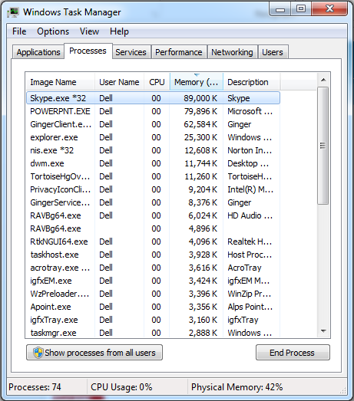
All the programs running on my machine. The CPU of course runs one program at a time. Switches between programs periodically.

Slide 6



Regarding all the memory being homogeneous → NOT TRUE
Cell Type
Area
Typical Latency
Master Slave D flip flop
0.8 ${μm}^{2}$
Fraction of a cycle
SRAM cell in an array
0.08 ${μm}^{2}$
1-5 cycles
DRAM cell in an array
0.005 ${μm}^{2}$
50-200 cycles
Typical Values
Should we make our memory using only flip-flops ?
10X the area of a memory with SRAM cells
160X the area of a memory with DRAM cells
Significantly more power !!!

Slide 7

Tradeoffs
Tradeoffs
Area, Power, and Latency
Increase Area → Reduce latency, increase power
Reduce latency → increase area, increase power
Reduce power → reduce area, increase latency
We cannot have
the best of all worlds

Slide 8
What do we do ?
We cannot create a memory of just flip flops
We will hardly be able to store anything
We cannot create a memory of just SRAM cells
We need more storage, and we will not have a 1 cycle latency
We cannot create a memory of DRAM cells
We cannot afford 50+ cycles per access

Slide 9
Memory Access Latency
What does memory access latency depend on ?
Size of the memory → larger is the size, slower it is
Number of ports → More are the ports (parallel accesses/cycle), slower is the memory
Technology used → SRAM, DRAM, flip-flops

Slide 10
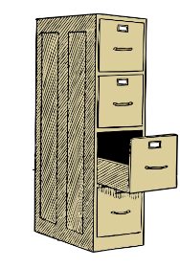
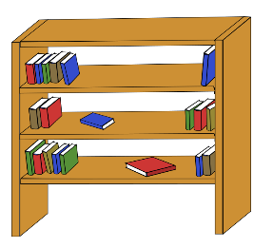
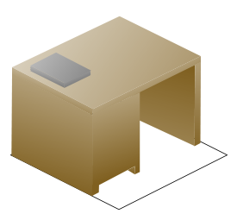
Solution : Leverage Patterns
Look at an example in real life
Sofia's workplace
shelf
cabinet
desk

Slide 11
A Protocol with Books
Sofia keeps the
most frequently accessed books on her desk
slightly less frequently accessed books on the shelf
rarely accessed books in the cabinet
Why ?
She tends to read the same set of books over and over again, in the same window of time → Temporal Locality

Slide 12

Protocol – II
If Sofia takes a computer architecture course
She has comp. architecture books on her desk
After the course is over
The architecture books go back to the shelf
And, vacation planning books come to the desk
Idea : Bring all the vacation planning books in one go. If she requires one, in high likelihood she might require similar books in the near future.

Slide 13
Temporal and Spatial Locality
Temporal Locality
It is a concept that states that if a resource is accessed at some point of
time, then most likely it will be accessed again in a short period of time.
Spatial Locality
It is a concept that states that if a resource is accessed at some point of
time, then most likely similar resources will be accessed again in the near
future.

Slide 14
Temporal Locality in Programs
Let us verify if programs have temporal locality
Stack distance
Have a stack to store memory addresses.
Whenever, we access an address → we bring it to the top of the stack
Stack distance → Distance from the top of the stack to where the element was found
Quantifies reuse of addresses

Slide 15
Stack Distance
top
stack
distance
memory address

Slide 16
Stack Distance Distribution
0.30
0.25
Most stack distances are very low → High Temporal Locality
0.20
y
t
i
l
i
b
a
0.15
b
o
r
p
0.10
0.05
0.00
0
50
100
150
200
250
stack distance
Benchmark : Set of perl programs

Slide 17
Address Distance
Maintain a sliding window of the last K memory accesses
Address distance :
The i^{th} address distance is the difference in the memory addresses of the i^{th} memory access, and the closest address in the set of last K memory accesses.
Shows the similarity in addresses

Slide 18
Address Distance Distribution
Address distances are typically ± 20 → High Spatial Locality
0.30
0.25
y
0.20
t
i
l
i
b
a
b
0.15
o
r
p
0.10
0.05
0.00
–100
–50
0
50
100
address distance
K=10, benchmark consisting of perl programs

Slide 19
Exploiting Temporal Locality
Cache hierarchy
L1 cache
L2 cache
Main memory
Use a hierarchical memory system
L1 (SRAM cells), L2 (SRAM cells), Main Memory (DRAM cells)

Slide 20
The Caches
The L1 cache is a small memory (8-64 KB) composed of SRAM cells
The L2 cache is larger and slower (128 KB – 4 MB) (SRAM cells)
The main memory is even larger (1 – 64 GB) (DRAM cells)
Cache hierarchy
The main memory contains all the memory locations
The caches contain a subset of memory locations

Slide 21
Access Protocol
Inclusive Cache Hierarcy
addresses(L1) ⊏ addresses(L2) ⊏ addresses(main memory)
Protocol
First access the L1 cache. If the memory location is present, we have a cache hit.
Perform the access (read/write)
Otherwise, we have a cache miss.
Fetch the value from the lower levels of the memory system, and populate the cache.
Follow this protocol recursively

Slide 22
Advantage
Typical Hit Rates, Latencies
L1 : 95 %, 1 cycle
L2 : 60 %, 10 cycles
Main Memory : 100 %, 300 cycles
Result :
95 % of the memory accesses take a single cycle
3 % take, 10 cycles
2 % take, 300 cycles

Slide 23

Exploiting Spatial Locality
Conclusion from the address locality plot
Most of the addresses are within +/- 25 bytes
Idea :
Group memory addresses into sets of n bytes
Each group is known as a cache line or cache block
A cache block is typically 32, 64, or 128 bytes
Reason: Once we fetch a block of 32/64 bytes. A lot of accesses in a short time interval will find their data in the block.

Slide 24
Outline
Overview of the Memory System
Caches
Details of the Memory System
Virtual Memory

Slide 25
Overview of a Basic Cache
Memory
Load value
address
Cache
Store value
Hit/Miss
Saves a subset of memory values
We can either have hit or miss
The load/store is successful if we have a hit

Slide 26
Basic Cache Operations
lookup → Check if the memory location is present
data read → read data from the cache
data write → write data to the cache
insert → insert a block into a cache
replace → find a candidate for replacement
evict → throw a block out of the cache

Slide 27
Cache Lookup
Running example : 8 KB Cache, block size of 64 bytes, 32 bit memory system
Let us have two SRAM arrays
tag array → Saves a part of the block address such that the block can be uniquely identified
block array → Saves the contents of the block
Both the arrays have the same number of entries

Slide 28
Structure of a Cache
Tag array
Data array
Address
Cache controller
Load
Store
value
value
Hit / Miss

Slide 29
Fully Associative Cache
We have 2¹³ / 2⁶ = 128 entries
A block can be saved in any entry
26 bit tag, and 6 bit offset
Hit/Miss
Tag array
(CAM cells)
Data array
Index of the
Encoder
matching entry
Tag
Address format
Tag
Offset

Slide 30
Implementation of the FA Cache
We use an array of CAM cells for the tag array
Each entry compares its contents with the tag
Sets the match line to 1
The OR gate computes a hit or miss
The encoder computes the index of the matching entry.
We then read the contents of the matching entry from the block array
Refer to Chapter 6: Digital Logic

Slide 31
Direct Mapped Cache
Tag array
Data array
Index
Index
Tag
Hit/Miss
Tag(19)
Index(7)
Offset(6)
Address format
Each block can be mapped to only 1 entry

Slide 32
Direct Mapped Cache
We have 128 entries in our cache.
We compute the index as idx = block address % 128
We access entry, idx, in the tag array and compare the contents of the tag (19 msb bits of the address)
If there is a match → hit
else → miss
Need a solution that is in the middle of the spectrum

Slide 33
Set Associative Cache
19
2
5
6
Index
Block
Tag
Let us assume that an address can reside in 4 locations
Access all 4 locations, and see if there is a hit
Thus, we have 128/4 = 32 indices
Each index points to a set of 4 entries
→ We now use a 21 bit tag, 5 bit index

Slide 34
Set Associative Cache
Hit/Miss
Data array
Tag array
Index of the
Tag array index
matched entry
generator
Set index
Encoder
Tag

Slide 35
Set Associative Cache
Let the index be i , and the number of elements in a set be k
We access indices, i*k, i*k+1 ,.., i*k + (k-1)
Read all the tags in the set
Compare the tags with the tag obtained from the address
Use an OR gate to compute a hit/ miss
Use an encoder to find the index of the matched entry

Slide 36
Set Associative Cache – II
Read the corresponding entry from the block array
Each entry in a set is known as a way
A cache with k blocks in a set is known as a k-way associative cache

Slide 37
Data read operation
This is a regular SRAM access.
Note that the data read and lookup can be overlapped for a load access
We can issue a parallel data read to all the ways in the cache
Once, we compute the index of the matching tag, we can choose the correct result with a multiplexer.

Slide 38
Data write operation
Before we write a value
We need to ensure that the block is present in the cache
Why ?
Otherwise, we have to maintain the indices of the bytes that were written to
We treat a block as an atomic unit
Hence, on a miss, we fetch the entire block first
Once a block is there in the cache
Go ahead and write to it ....

Slide 39
Modified bit
Maintain a modified bit in the tag array.
If a block has been written to, after it was fetched, set it to 1.
Modified
Tag
bit

Slide 40
Write Policies
Write through → Whenever we write to a cache, we also write to its lower level
Advantage : Can seamlessly evict data from the cache
Write back → We do not write to the lower level. Whenever we write, we set the modified bit.
At the time of eviction of the line, we check the value of the modified bit

Slide 41
insert operation
If we don’t find a block in a cache. We fetch it from the lower level. Then we insert the block in the cache → insert operation
Let us add a valid bit to a tag
If the line is non-empty, valid bit is 1
Else it is 0
Structure of a tag
Valid bit
Modified
Tag
bit

Slide 42
insert operation - II
Check if any way in a set has an invalid line
If there is one, then write the fetched line to that location, set the valid bit to 1.
Otherwise,
find a candidate for replacement

Slide 43
The replace operation
A cache replacement scheme or replacement policy is a method to replace an entry in the set by a new entry
Replacement Schemes
Random replacement scheme
FIFO replacement scheme
When we fetch a block, assign it a counter value equal to 0
Increment the counters of the rest of the ways

Slide 44
Replacement Schemes
FIFO
For replacement, choose the way with the highest counter (oldest).
Problems :
Can violate the principle of temporal locality
A line fetched early might be accessed very frequently.

Slide 45
LRU (least recently used)
Replace the block that has been accessed the least in the recent past
Most likely we will not access it in the near future
Directly follows from the definition of stack distance
Sadly, we need to do more work per access
Proved to be optimal in some restrictive scenarios
True LRU requires saving a hefty timestamp with every way
Let us implement pseudo-LRU

Slide 46
Psuedo-LRU
Let us try to mark the most recently used (MRU) elements.
Let us associate a 3 bit counter with every way.
Whenever we access a line, we increment the counter.
We stop incrementing beyond 7.
We periodically decrement all the counters in a set by 1.
Set the counter to 7 for a newly fetched block
For replacement, choose the block with the smallest counter.

Slide 47
evict Operation
If the cache is write-through
Nothing needs to be done
If the cache is write-back
AND the modified bit is 1
Write the line to the lower level

Slide 48
The read(load) Operation
Time
insert
replace
evict
insert
lookup
lookup
read block
if write
hit
data read
miss
back cache
Lower level
Lower level
cache
cache

Slide 49
Write operation in a write back cache
Time
write
lookup
lookup
block
insert
replace
evict
insert
hit
data write
miss
Lower level
Lower level
cache
cache

Slide 50
Write operation in a write through cache
Time
lookup
write
lookup
block
insert
replace
evict
insert
hit
data write
miss
Lower level
Lower level
cache
cache

Slide 51
Outline
Overview of the Memory System
Caches
Details of the Memory System
Virtual Memory

Slide 52
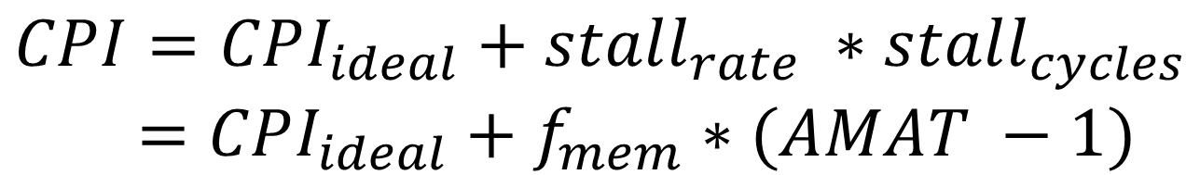
Mathematical Model of the Memory System
$$CPI=CPI_{ideal}+stall_{rate} ∗stall_{cycles} \\ =CPI_{ideal}+f_{mem}∗(AMAT −1)$$
AMAT → Average Memory Access Time
f_{mem} → Fraction of memory instructions
CPI_{ideal} → ideal CPI assuming a perfect 1 cycle memory system

Slide 53
Equation for AMAT
$$AMAT=L1_{hit time}+L1_{miss rate} ∗L1_{\begin{aligned}miss penalty \\ \end{aligned}}$$
$=L1_{hit time}+L1_{miss rate } ∗(L2_{hit time}+L2_{miss rate} ∗L2_{miss penalty})$
Irrespective of an hit or a miss, we need to spend some time (hit time)
This is the hit time in the L1 cache (L1_{hit time})
This time should be discarded while calculating the stall penalty due to L1 misses
stall penalty = AMAT - L1_{hit time}

Slide 54
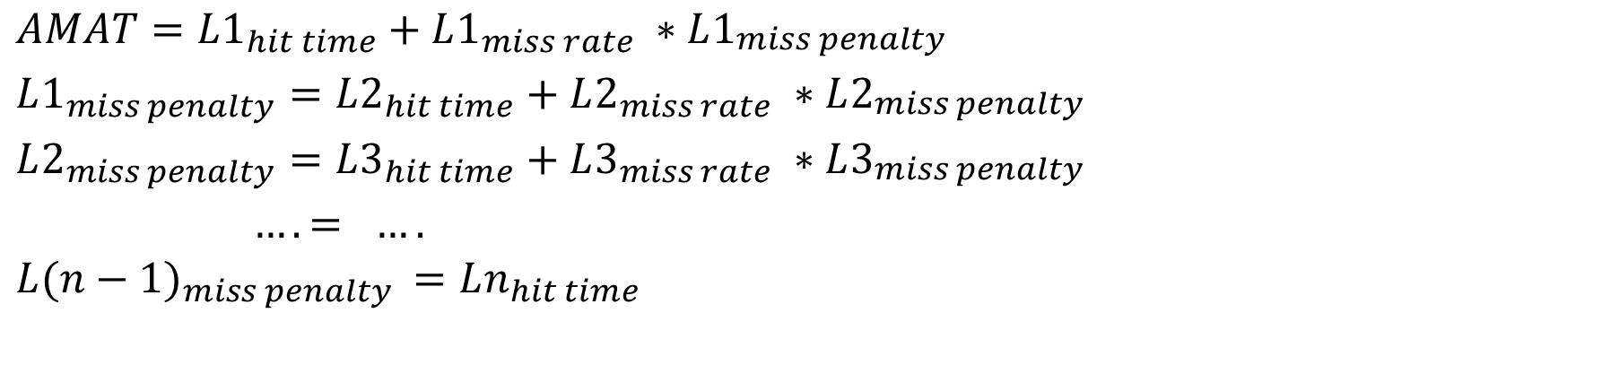
n-Level Memory System
$$AMAT=L1_{hit time}+L1_{miss rate} ∗L1_{\begin{aligned}miss penalty \\ \end{aligned}} \\ L1_{miss penalty}=L2_{hit time}+L2_{miss rate} ∗L2_{\begin{aligned}miss penalty \\ \end{aligned}}$$
$$L2_{miss penalty}=L3_{hit time}+L3_{miss rate} ∗L3_{\begin{aligned}miss penalty \\ \end{aligned}} \\ …. = ….$$
$$L(n−1)_{miss penalty }=Ln_{hit time}$$

Slide 55
Definition: Local and Global Miss Rates, Working Set
local miss rate
It is equal to the number of misses in a cache at level i divided by the total number of accesses at
level i.
global miss rate
It is equal to the number of misses in a cache at level i divided by the total number of memory
accesses.
working set
The amount of memory, a given program
requires in a time interval.

Slide 56
Types of Misses
Compulsory Misses
Misses that happen when we read in a piece of data for the first time.
Conflict Misses
Misses that occur due to the limited amount of associativity in a set associative or direct mapped cache. Example: Assume that 5 blocks (accessed by the program) map to the same set in a 4-way associative cache. Only 4 out of 5 can be accommodated.
Capacity Misses
Misses that occur due to the limited size of a cache. Example: Assume the working set of a program is 10 KB, and the cache size is 8 KB.

Slide 57
Schemes to Mitigate Misses
Compulsory Misses
Increase the block size. We can bring in more data in one go, and due to spatial locality the number of misses might go down.
Try to guess the memory locations that will be accessed in the near future. Prefetch (fetch in advance) those locations. We can do this for example in the case of array accesses.

Slide 58
Schemes to Mitigate Misses - II
Conflict Misses
Increase the associativity of the cache (at the cost of latency and power)
We can use a smaller fully associative cache called the victim cache . Any line that gets displaced from the main cache can be put in the victim cache. The processor needs to check both the L1 and victim cache, before proceeding to the L2 cache.
Write programs in a cache friendly way.

Slide 59
Victim Cache
Processor
R
R
R
L1 cache
Victim Cache
L2 cache

Slide 60
Schemes to Mitigate Misses - III
Capacity Misses
Increase the size of the cache
Use better prefetching techniques.

Slide 61
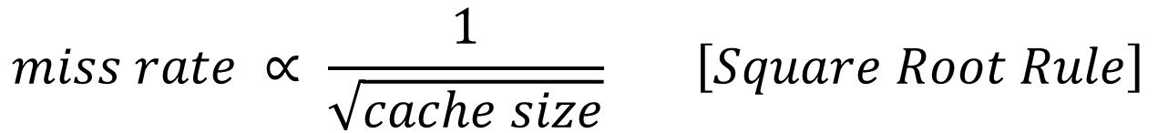
Some Thumb Rules
$$miss rate ∝ \frac{1}{\sqrt{cache size}} \left[Square Root Rule\right]$$
Associativity Rule → Doubling the associativity is almost the same as doubling the cache size with the original associativity
64 KB, 4 way ←→ 128 KB, 2 way

Slide 62
Software Prefetching
int addAll(int data[], int vals[]) {
int i, sum = 0;
for (i=0; i < N; i++)
sum += data[vals[i]];
return sum;
}
int addAllP(int data[], int vals[]) {
int i, sum = 0;
for (i=0; i < N; i++) {
__builtin_prefetch(& data[vals[i+100]] );
sum += data[vals[i]];
}
return sum;
}
Original Code
Modified Code
with
Prefetching

Slide 63
Hardware Prefetching
Processor
Prefetcher
L1 cache
L2 cache

Slide 64
Reduction of Hit Time and Miss Penalty
For reducing the hit time, we need to use smaller and simpler caches
For reducing the miss penalty :
Write misses
Send the writes to a fully associative write buffer on an L1 miss.
Once the block comes from the L2 cache, merge the write
Insight: We need not send separate writes to the L2 for each write request in a block.
Processor
L1 cache
Write
buffer
L2 cache

Slide 65
Reduction of the Miss Penalty
Read Miss
Critical Word First : The memory word that cause the read/write miss is fetched first from the lower level. The rest of the block follows.
Early Restart : Send the critical word to the processor, and make it restart its execution.

Slide 66
Technique | Application | Disadvantages
large block size | compulsory misses | reduces the number of blocks in the cache
prefetching | compulsory misses, capacity misses | extra complexity and the risk of displacing useful data from the cache
large cache size | capacity misses | high latency, high power, more area
increased associativity | conflict misses | high latency, high power
victim cache | conflict misses | extra complexity
compiler based techniques | all types of misses | not very generic
small and simple cache | hit time | high miss rate
write buffer | miss penalty | extra complexity
critical word first | miss penalty | extra complexity and state
early restart | miss penalty | extra complexity

Slide 67
Outline
Overview of the Memory System
Caches
Details of the Memory System
Virtual Memory

Slide 68
Need for Virtual Memory
Up till now we have assumed that a program perceives the entire memory system to be its own
Furthermore, every program on a 32 bit machine assumes that it owns 4 GB of memory space, and it can access any location at will
We now need to take multiple programs into account. The CPU runs program A for some time, then switches to program B, and then to program C. Do they corrupt each other’s data?
Secondly, we need to design memory systems that have less than 4 GB of memory (for a 32 bit memory address)

Slide 69
Let us thus define two concepts ...
Physical Memory
Refers to the actual set of physical memory locations contained in the main memory, and the caches.
Virtual Memory
The memory space assumed by a program.
Contiguous, without limits.

Slide 70
Virtual Memory Map of a Process (in Linux)
0xC0000000
Stack
Memory mapping
segment
Heap
Bss
Static variables not initialized, filled with 0s
Data
Static variables with initialized values
Text
Header
0x08048000
0

Slide 71
Memory Maps Across Operating Systems
OS kernel
1 GB
OS kernel
2 GB
User programs
3 GB
User programs
2 GB
Linux
Windows

Slide 72
Address Translation
Virtual
Address
translation
Physical
address
system
address
Convert a virtual address to a physical address to satisfy all the aims of the virtual memory system

Slide 73
Pages and Frames
Divide the virtual address space into chunks of 4 kB → page
Divide the physical address space into chunks of 4 kB → frame
Map pages to frames
Insight: If a page/frame size is large, most of it may remain unused
If the page/frame size is very small, the overhead of mapping will be very high

Slide 74
Map Pages to Frames
Virtual memory of program A
Physical memory
Virtual memory of program B
Page
Frame

Slide 75
Example of Page Translation
20
12
Virtual
address
Page number
Offset
Page
table
Physical
address
Frame number
Offset
20
12

Slide 76
Single Level Page Table
Page table
20
Page number
Frame number
20

Slide 77

Issues with the Single Level Page Table
Size of the single level page table
Size of an entry (20 bits = 2.5 bytes) *
Number of entries (2²⁰ = 1 million)
Total → 2.5 MB
For 200 processes (running instances of programs)
We spend 500 MB in saving page tables (not acceptable)
Insight : Most of the virtual address space is empty
Most programs do not require that much of memory
They require maybe 100 MBs or 200 MBs (most of the time)

Slide 78
Two Level Page Table
20
Primary page
Page number
table
10
10
20
Frame number
Secondary page tables

Slide 79
Two Level Page Tables - II
We have a two level set of page tables
Primary and secondary page tables
Not all the entries of the primary page table point to valid secondary page tables
Each secondary page table → 1024 * 2.5 B = 2.5 KB
Maps 4MB of virtual memory
Insight: Allocate only those many secondary page tables as required.
We do not need many secondary page tables due to spatial locality in programs
Example: If a program uses 100 MB of virtual memory and needs 25 secondary page tables, we need a total of 2.5KB * 25 = 62.5 KB of space for saving secondary page tables (minimal).

Slide 80
Inverted Page Table
Inverted
page table
20
Frame number
Page number
20
(a)
20
Inverted
Page number
Pid
page table
Compare the page
Hashtable
num, process id with
each entry
Hashing
engine
Frame number
20
(b)
Advantage: One page table for the entire system

Slide 81
Memory Access
Processor
MMU (Memory Mgmt. Unit)
Caches
Every access needs to go through the MMU (memory management unit)
It will access the page tables, which themselves are stored in memory (very slow)
Fast mechanism → Cache N recent mappings. Due to temporal and spatial locality, we should observe a very high hit rate. We need not access the page tables for every access.

Slide 82
Memory Access with a TLB
Processor
TLB
Caches
Page Tables

Slide 83
TLB
TLB (Translation Lookaside Buffer)
A fully associative cache
Each entry contains a page → frame (mapping)
Typically contains 64 entries
Very few accesses go to the page table.
Accesses that go to the page table
If there is no mapping, we have a page fault
On a page fault, create a mapping, and allocate an empty frame in memory. Update the list of empty frames.

Slide 84
Swap Space
Consider a system with 500 MB of main memory.
Can we run a program that requires 1 GB of main memory ?
YES
Add an additional entry in the page table.
bit → Is the frame found in main memory, or somewhere else (???)
Hard disk (studied later) contains a dedicated area to save frames that do not fit in main memory. This area is known as the swap space.

Slide 85
System with a Hard Disk
Processor
L1
L2
Main Memory
Swap space
Hard Disk

Slide 86
Flowchart
Memory
access
Yes
Send mapping
TLB hit?
to processor
No
Yes
Populate
Send mapping
Page table
hit?
TLB
to processor
No
Free frame
No
(1) Evict a frame
available?
to swap space
(2) Update its page
Yes
table
Read in the new frame
from swap space (if possible),
or create a new empy frame
Create/update mapping
in the page table
Populate
Send mapping
TLB
to processor

Slide 87
Advanced Features
Shared Memory → Sometimes it is necessary for two processes to share data. We can map two pages in each virtual address space to the same physical frame.
Protection → The pages in the text section are marked as read-only. The program thus cannot be modified.

Slide 88
THE END

